Slide 2




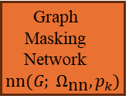



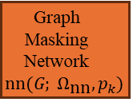

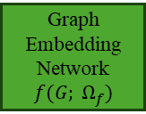
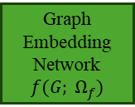





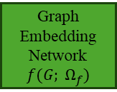





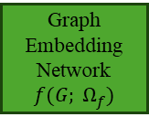

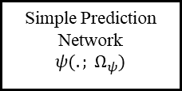
Input Graph
Graph Embedding Network
$$f(G; Ω_{f})$$
$${\hat{p}}_{G}$$
Graph Prototypes
Graph Masking Network$nn(G; Ω_{\text{nn}}, p_{k})$
Graph Embedding Network
$$f(G; Ω_{f})$$
$${\hat{p}}_{G_{1}}$$
Graph Embedding Network
$$f(G; Ω_{f})$$
$$p_{1}$$
$$G_{1}$$
$$\tilde{G_{1}}$$
.
.
.
.
.
.
.
.
.
.
.
.
.
.
.
.
.
.
Graph Masking Network$nn(G; Ω_{\text{nn}}, p_{k})$
Graph Embedding Network
$$f(G; Ω_{f})$$
$${\hat{p}}_{G_{mC}}$$
Graph Embedding Network
$$f(G; Ω_{f})$$
$$p_{mC}$$
$$G$$
$$G_{mC}$$
$${\tilde{G}}_{mC}$$
$${\hat{p}}_{G}$$
$${\hat{p}}_{G_{1}}$$
.
.
.
$${\hat{p}}_{G_{mC}}$$
$$G$$
$$G_{1}$$
.
.
.
$$G_{mC}$$
Simple Prediction Network
$$ψ(. ; Ω_{ψ})$$
Similarity Scores
$$p_{1}$$
.
.
.
$$p_{mC}$$
$$\tilde{G_{1}}$$
$${\tilde{G}}_{mC}$$

Slide 3
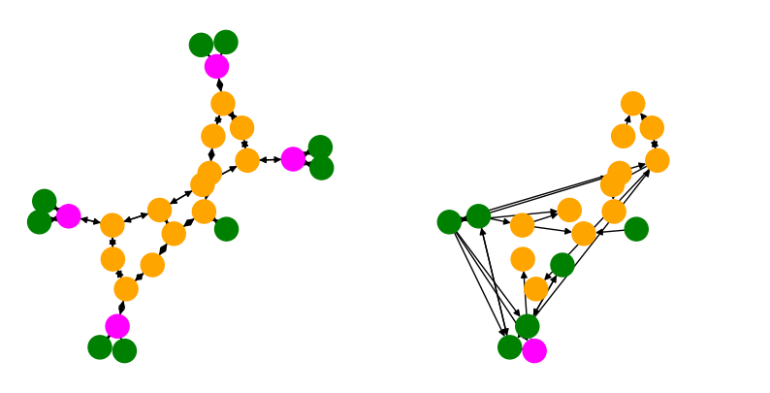
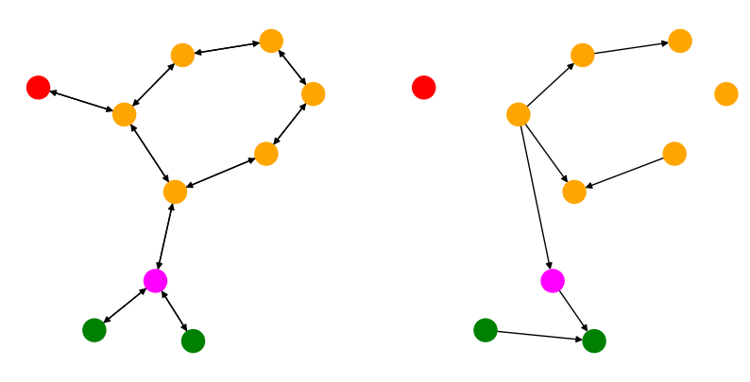
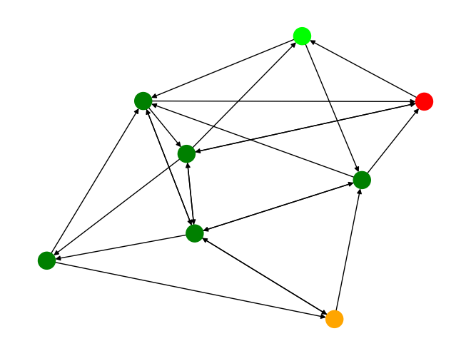
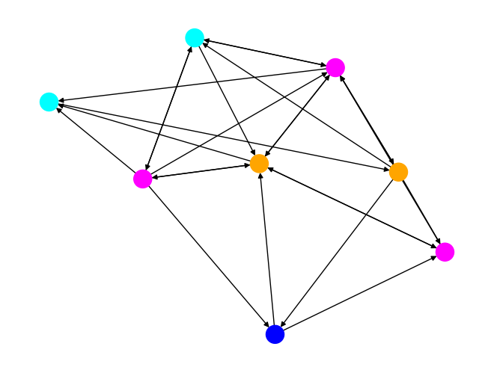
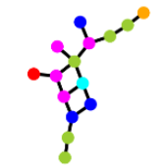
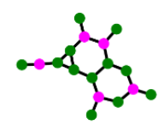

(a)
(b)
(c)
(d)
(e)
(f)
(g)
(h)

